Slide 1

Geometry
Unit 13, Lesson 13 Finding Perimeter and Area on the Coordinate Plane Volume 2, pg. 354

Slide 2


Benchmark
MA.912.GR.3.4
Use coordinate geometry to solve mathematical and real-world problems on the coordinate plane involving the perimeter or area of polygons.
volume 2, pg. 354

Slide 3
Integrated Mathematical Thinking and Reasoning Standards
MA.K12.MTR.1.1 Actively participate in effortful learning both individually and collectively.
MA.K12.MTR.3.1 Complete tasks with mathematical fluency.
MA.K12.MTR.4.1 Engage in discussions that reflect on the mathematical thinking of self and others.
MA.K12.MTR.5.1 Use patterns and structure to help understand and connect mathematical concepts.
volume 2, pg. 354

Slide 4

Learning Target
I can find the perimeter and area of polygons and composite figures drawn on the coordinate plane.
volume 2, pg. 354

Slide 5

Warm-Up
volume 2, pg. 355

Slide 6
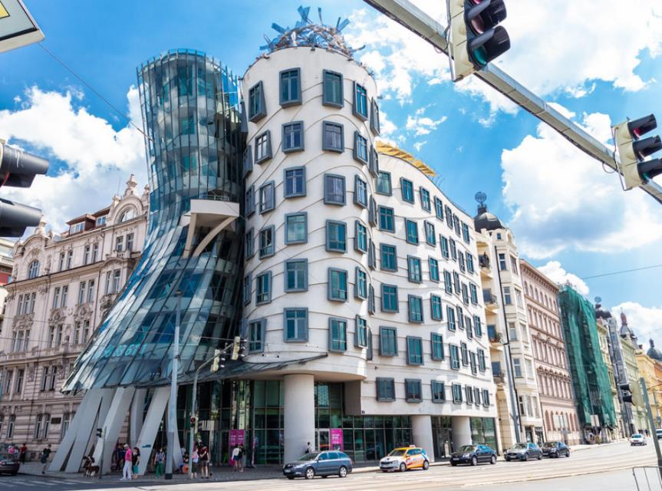
13.13.1 Warm-Up: The Dancing House
The Dancing House is located in Prague, Czech Republic, and was designed in 1992. The style of this building is known as deconstructivist architecture due to its unusual shape.
volume 2, pg. 355

Slide 7
What is the first question that comes to your mind?
Write a question that a 5th grader could answer using the photo.
volume 2, pg. 355

Slide 8

Exploration
volume 2, pg. 355

Slide 9

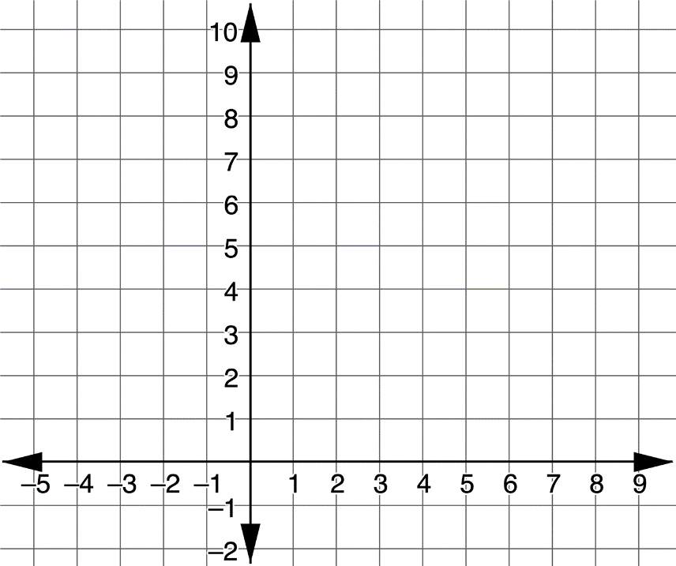
13.13.2 Exploration: Perimeter and Area
Trapezoid 𝐵𝐺𝑀𝐻 has vertices at $B(1,9)$, $G(5,9)$, $M(2,5)$, and $H(−4,5)$.
Graph 𝐵𝐺𝑀𝐻.
volume 2, pg. 355

Slide 10
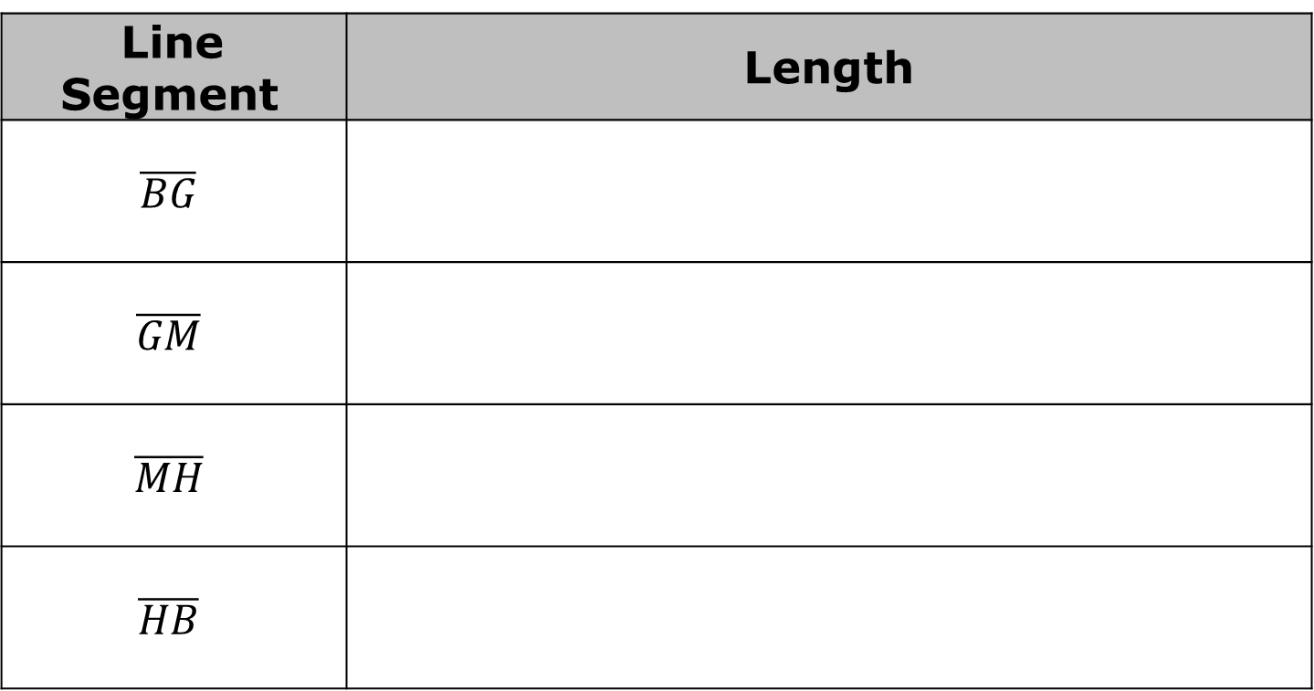
Complete the table.
Line Segment | Length
$$\overline{BG}$$
$$\overline{GM}$$
$$\overline{MH}$$
$$\overline{HB}$$
volume 2, pg. 355

Slide 11
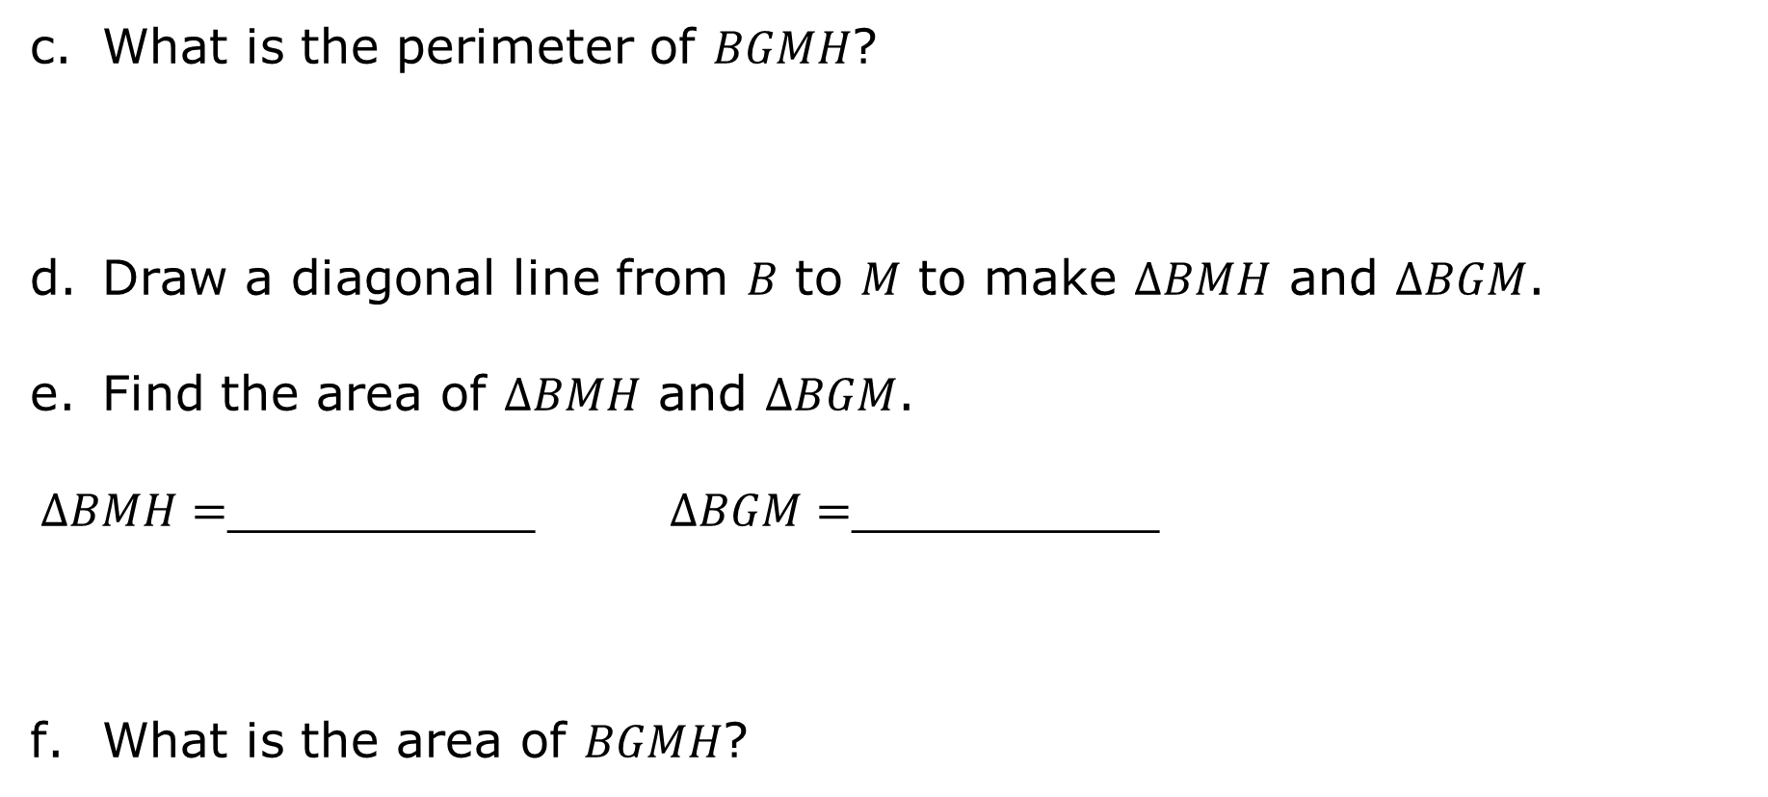
What is the perimeter of 𝐵𝐺𝑀𝐻?
Draw a diagonal line from 𝐵 to 𝑀 to make $∆BMH$ and $∆BGM$.
Find the area of $∆BMH$ and $∆BGM$.
$∆BMH=$__________ $∆BGM=$__________
What is the area of 𝐵𝐺𝑀𝐻?
volume 2, pg. 356

Slide 12

Parallelogram 𝐺𝑃𝐾𝑀 has vertices at $G(5,9)$, $P(5,6)$, $K(2,2)$, and $M(2,5)$.
volume 2, pg. 356

Slide 13
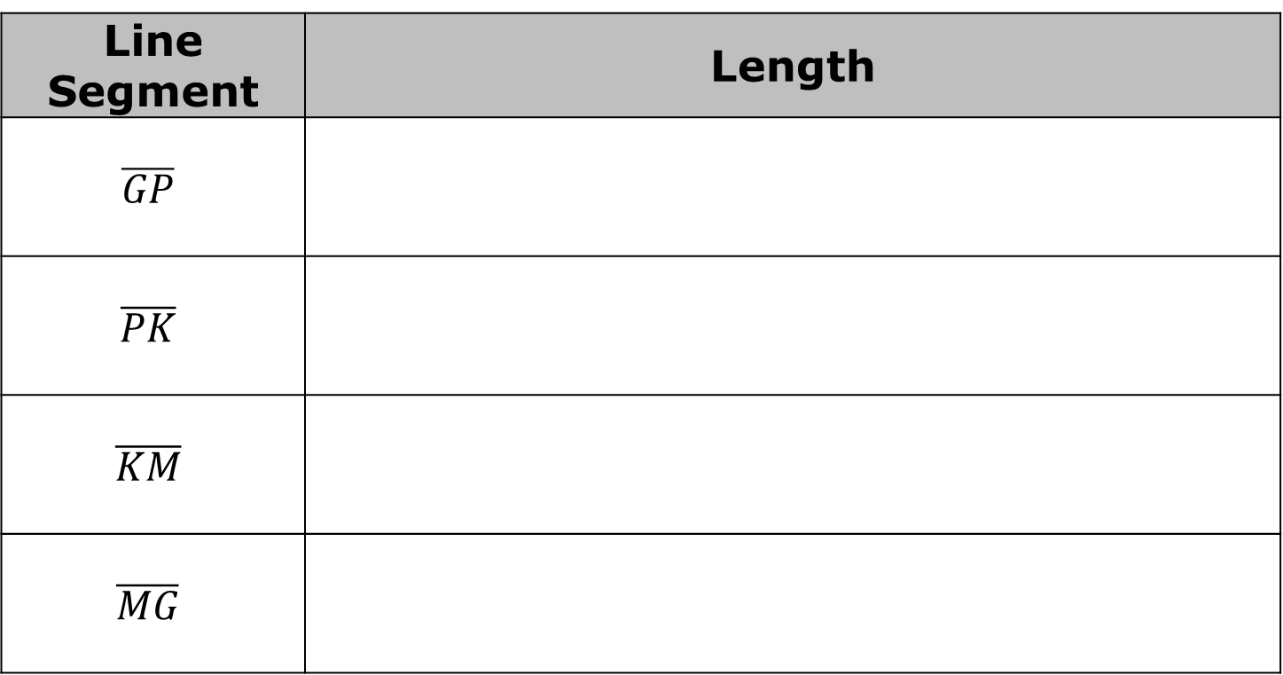
Graph 𝐺𝑃𝐾𝑀.
Complete the table.
Line Segment | Length
$$\overline{GP}$$
$$\overline{PK}$$
$$\overline{KM}$$
$$\overline{MG}$$
volume 2, pg. 356

Slide 14
What is the perimeter of 𝐺𝑃𝐾𝑀?
What is the area of 𝐺𝑃𝐾𝑀?
volume 2, pg. 357

Slide 15
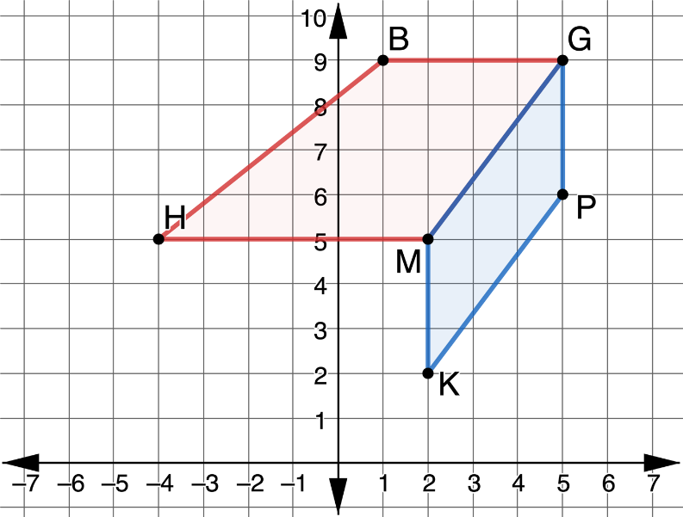
The figure shown is created by trapezoid 𝐵𝐺𝑀𝐻 and parallelogram 𝐺𝑃𝐾𝑀.
What do you notice about this figure?
volume 2, pg. 357

Slide 16

A composite figure is a two- or three-dimensional figure that can be decomposed into smaller figures.
Explain why this figure is considered a composite figure.
How could you find the perimeter of a composite figure?
volume 2, pg. 357

Slide 17
What is the perimeter of composite figure 𝐵𝐺𝑃𝐾𝑀𝐻?
Explain why the perimeter of the composite figure is not the sum of the perimeters of the parallelogram and the trapezoid.
What is the area of 𝐵𝐺𝑃𝐾𝑀𝐻?
volume 2, pg. 357

Slide 18

Try It
volume 2, pg. 358

Slide 19
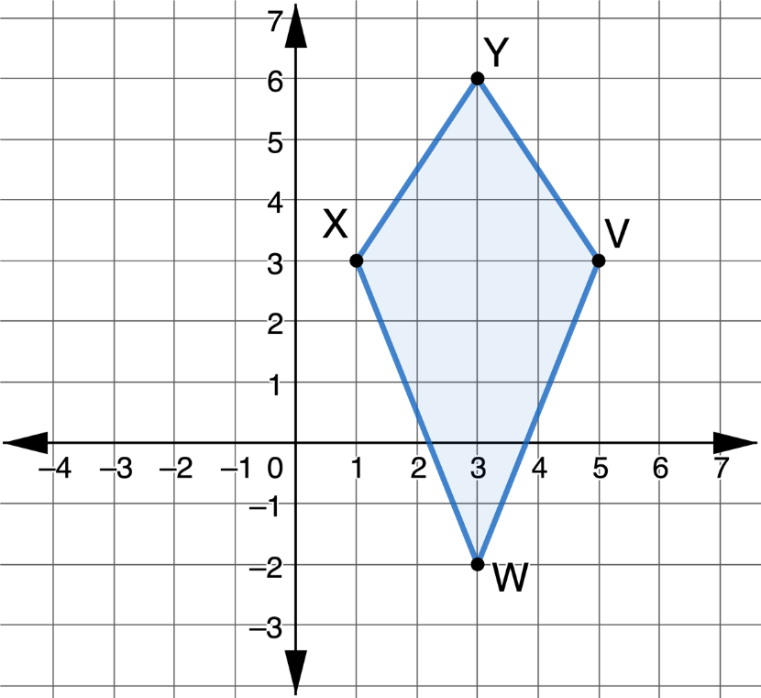
13.13.3 Try It: Perimeter and Area
Kite 𝑌𝑉𝑊𝑋 is shown with vertices at $Y(3,6)$, $V(5,3)$, $W(3,−2)$, and $X(1,3)$.
volume 2, pg. 358

Slide 20
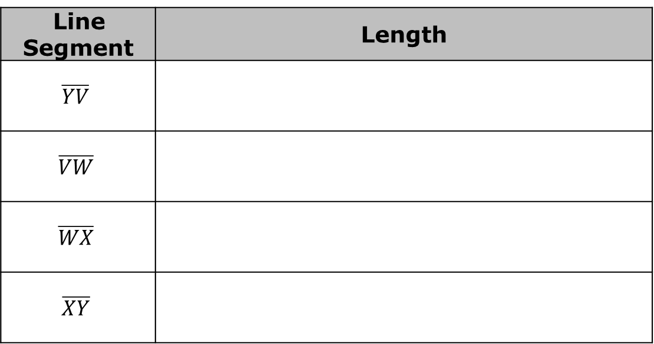
Complete the table.
Line Segment | Length
$$\overline{YV}$$
$$\overline{VW}$$
$$\overline{WX}$$
$$\overline{XY}$$
What is the perimeter of 𝑌𝑉𝑊𝑋?
volume 2, pg. 358

Slide 21
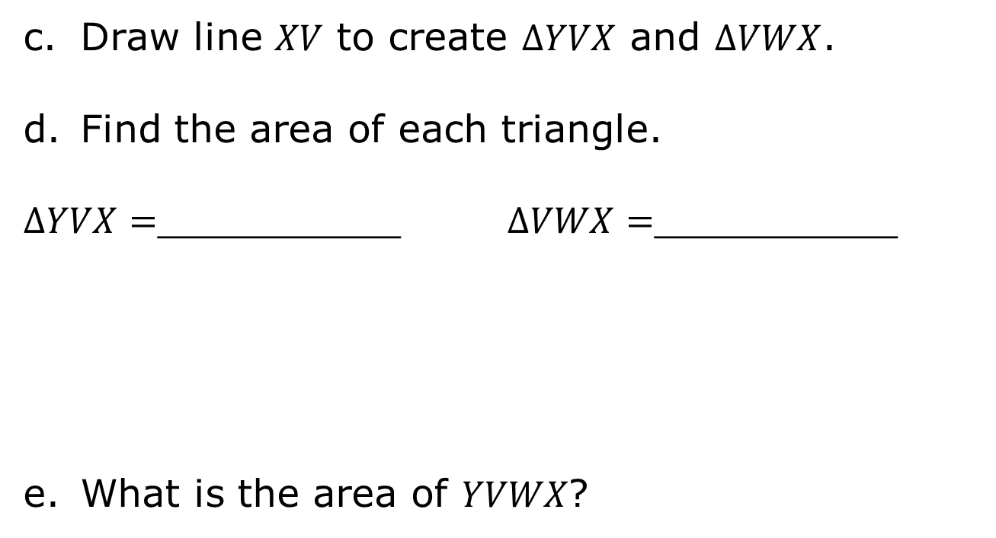
Draw line 𝑋𝑉 to create $∆YVX$ and $∆VWX$.
Find the area of each triangle.
$∆YVX=$__________ $∆VWX=$__________
What is the area of 𝑌𝑉𝑊𝑋?
volume 2, pg. 358

Slide 22
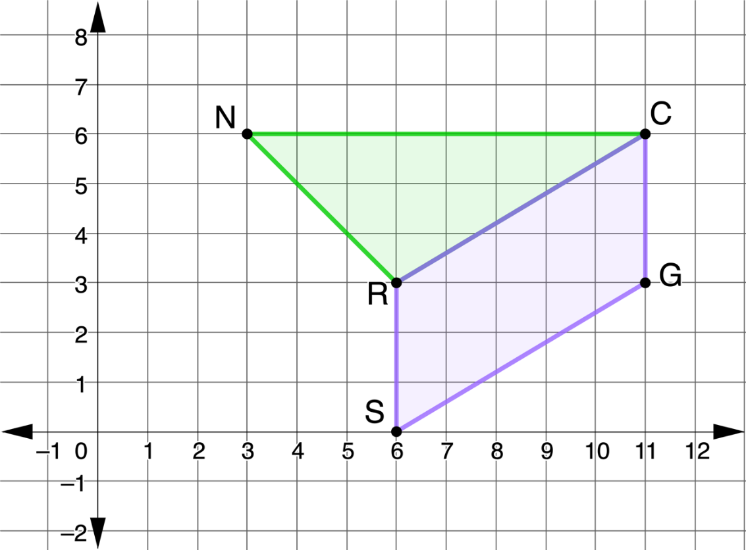
The composite figure shown is created by $∆NCR$ and parallelogram 𝑅𝐶𝐺𝑆. $N(3,6)$, $C(11,6)$, $G(11,3)$, $S(6,0)$, and $R(6,3)$.
volume 2, pg. 359

Slide 23
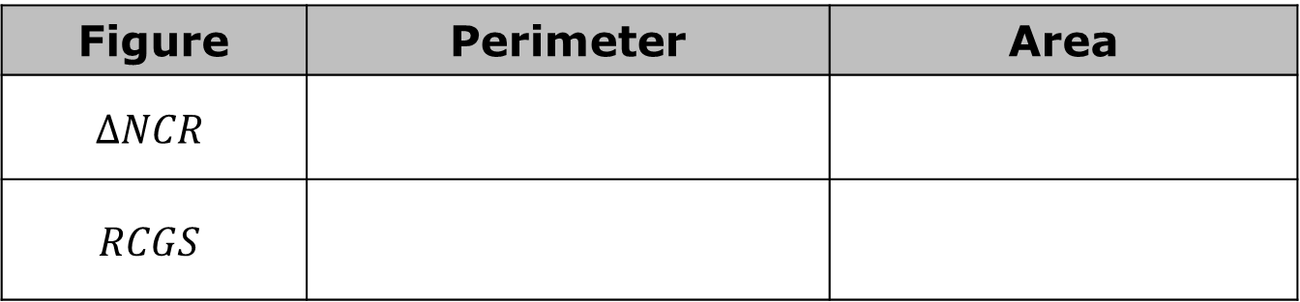
Complete the table. Round your answer to the nearest thousandth.
Figure | Perimeter | Area
$$∆NCR$$
$$RCGS$$
What is the perimeter of the composite figure?
What is the area of the composite figure?
volume 2, pg. 359

Slide 24

Wrap-Up
volume 2, pg. 359

Slide 25
13.13.4 Wrap-Up: Cool Down
What is something that is now “squared away” in your mind about finding the perimeter and area of polygons and composite figures drawn on a coordinate plane?
volume 2, pg. 359

Slide 26
What are three “points” that are important about finding the perimeter and area of polygons and composite figures drawn on a coordinate plane?
What is something that is still “circling” your brain about finding the perimeter and area of polygons and composite figures drawn on a coordinate plane?
volume 2, pg. 359

